Slide 1
Employee Survey Analysis
Attrition, Salary, and more

Slide 2


Survey Facts
870 Employees surveyed
Over 35 question analyzed
Survey contained objective and factual responses

Slide 3


Analysis Goals
Find out what factors contribute to attrition
Analyze the relationship of Salary to the other response variables
MORE!

Slide 4
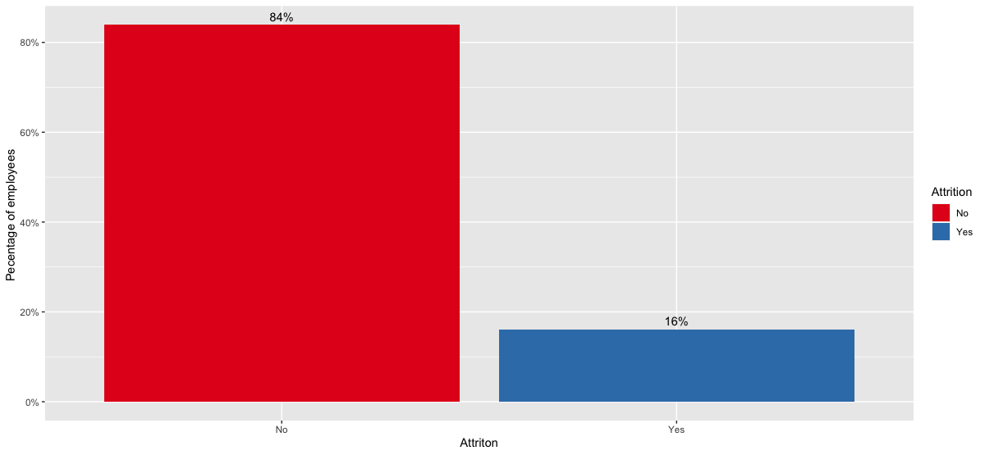
Attrition - Overall

Slide 5
Attrittion – Top 3 Factors
OverTime
Familiarity with current Manager
Job Happiness

Slide 6
Attribution caused by Overtime work?
33% more employees with attrition also worked over time
Pearson's Chi-squared test with Yates' continuity correction
p-value = 2.333e-15
Attrition
No Attrition

Slide 7
Attrition reduced by building familiarity with leadership?
Attrition: Mean of 2.9 Years with current Manager
No Attrition: Mean of 4.4 Years with current Manager
Wilcoxon rank sum test
p-value = 9.347e-07

Slide 8
Job Happiness vs. Attrition
For Job Happiness we combined survey results for Job Satisfaction and Job Involvement (Scale 1-5 each)
Attrition: Mean combined score of 4.8
No Attrition: Mean combined score of 5.5
Wilcoxon rank sum test
p-value = 6.325e-08

Slide 9
Monthly Income vs Attrition
Attrition: Mean Monthly Income of 4,765
No Attrition: Mean Monthly Income of 6,702
Wilcoxon rank sum test
p-value = 4.074e-09
In line with results of Job Level vs Attrition analysis

Slide 10
Monthly Income by Job Level
Roughly 3-5k increase in monthly Income as Job Level increases

Slide 11
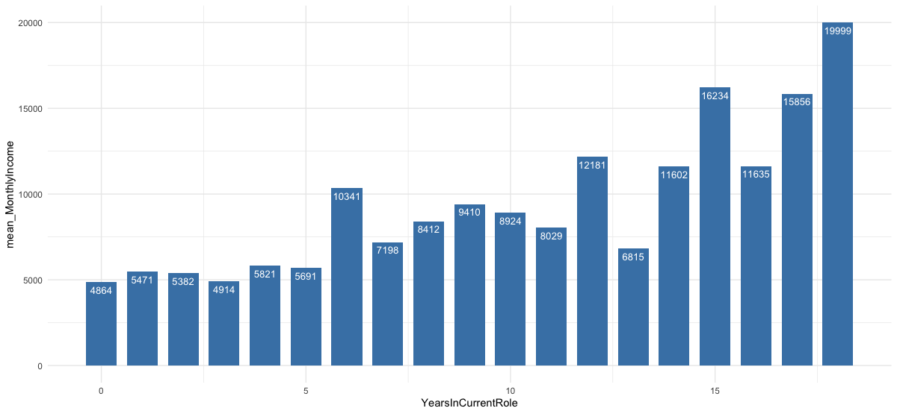
Income Progression in each role

Slide 12
Income progression by Department

Slide 13
Income Progression by Gender

Slide 14
Income progression by Job role/level

Slide 15

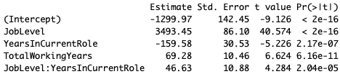
Prediction Models
Attrition Naïve Bayes model:
Uses over 30 factors
Accuracy ~ 85%
Sensitivity ~ 85%
Specificity ~ 65%
Monthly Income Linear regression
Parameter estimates and p-values:
RMSE: 1,366k
p-value: < 2.2e-16

Slide 16
Summary and findings
Top 3 Factors contributing to Attrition
Over Time
Familiarity with Management
Job Satisfaction and Involvement
Monthly Income fits Linear model with the variables:
Job Level
Year in Current Role
Total Working Years

